Slide 1
X-ray diffraction at extreme conditions: tools and practice
High pressure environments

Slide 2

H
P
igh
ressure

Slide 3
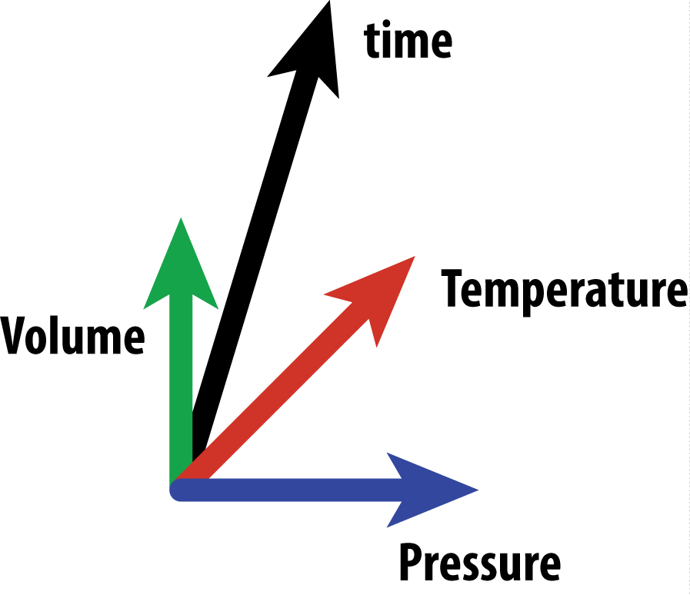
Extreme high pressure P-V-T-t
specific states of matter
phase equilibria
fundamental materials
applied materials

Slide 4

Classification of compression experiments
By volume
By compression rate
Small volume
Small volume
Static compression
DAC – dia. anvil cell
DAC – dia. anvil cell
Dynamic compression
Large volume
Based on static compression
Drickhamer press
Based on shock compression
Paris-Edinburgh press
Multi-anvil press

Slide 5
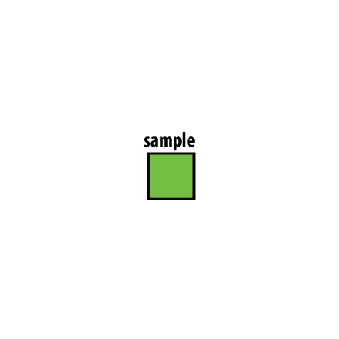
Compression

Slide 6
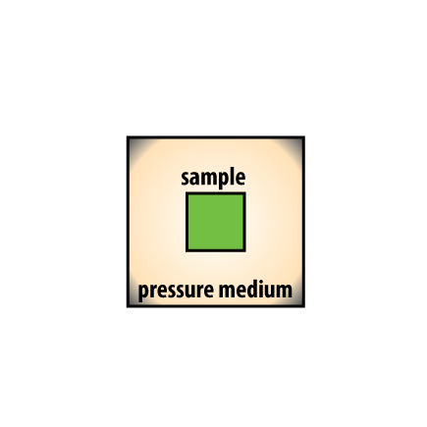
Compression

Slide 7
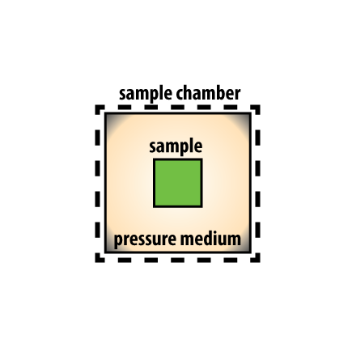
Compression

Slide 8
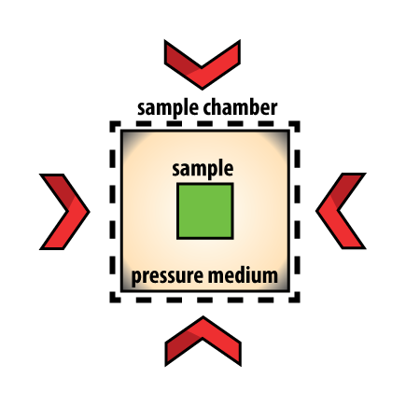
Compression

Slide 9
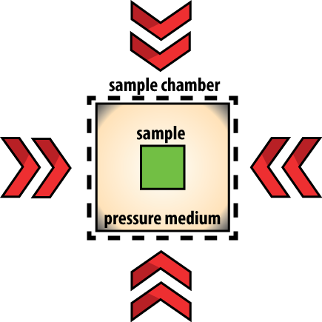
Compression

Slide 10

Compression

Slide 11
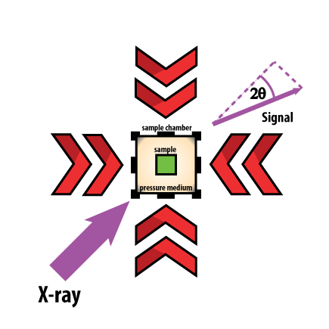
Compression

Slide 12
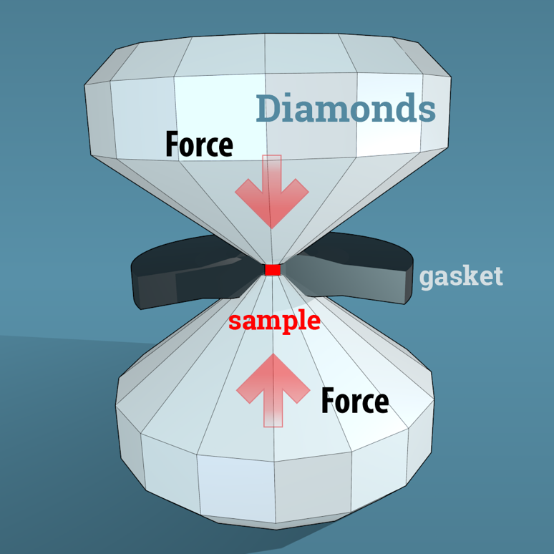
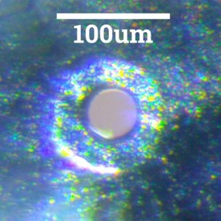
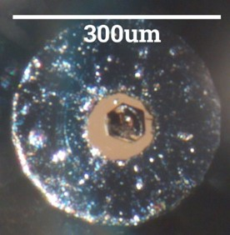
Compact environments – diamond anvil cell

Slide 13
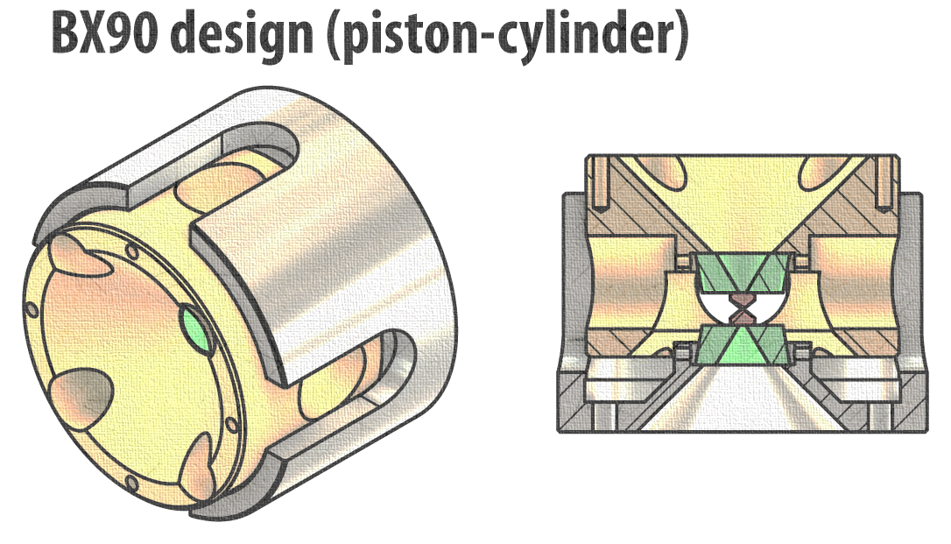
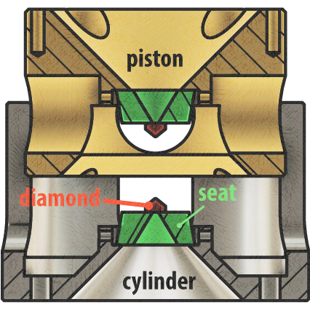
Compact environments – diamond anvil cell
BGI design
sliding
surface
Pressurized cell
Open cell

Slide 14
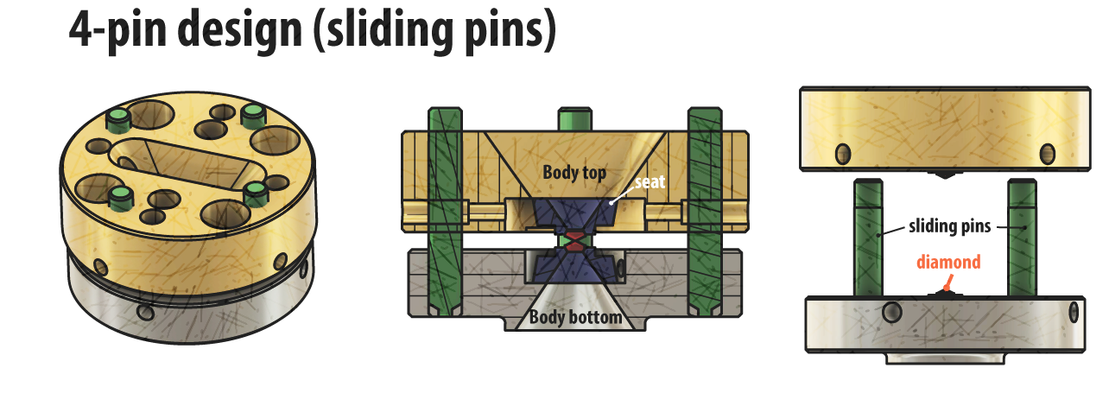
Compact environments – diamond anvil cell
Lawrence-Livermore design
sliding
surface
Pressurized cell
Open cell

Slide 15
How many screws does a student need to pressurize a DAC?
How many screws does a professor need to pressurize a DAC?

Slide 16
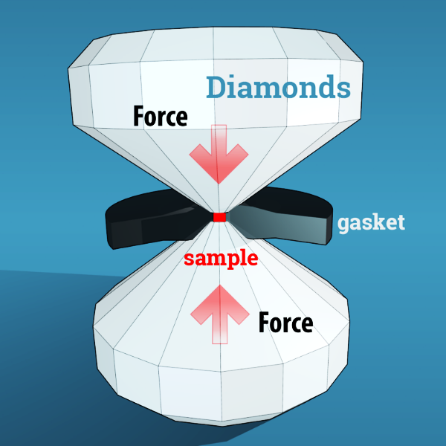
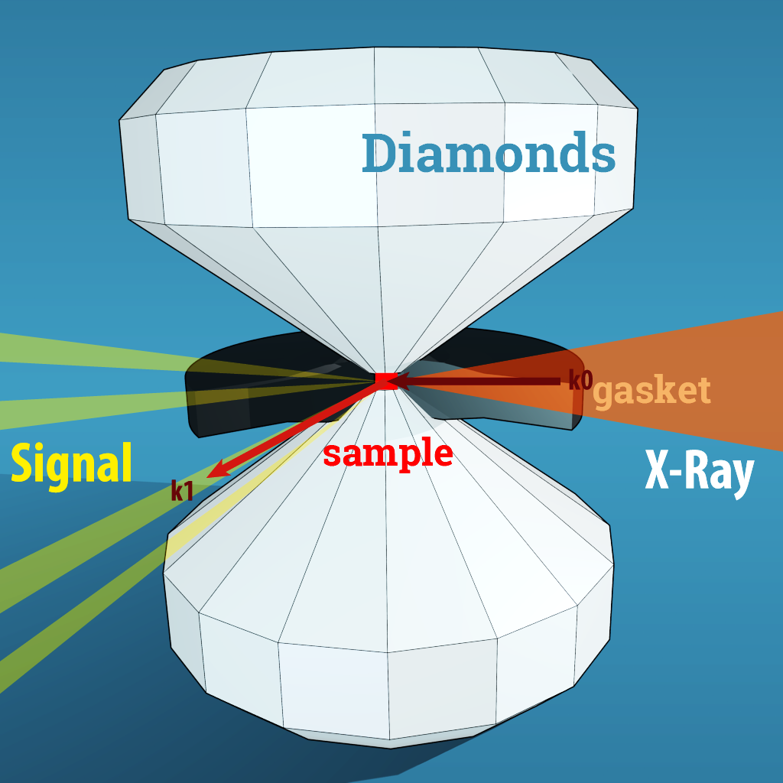
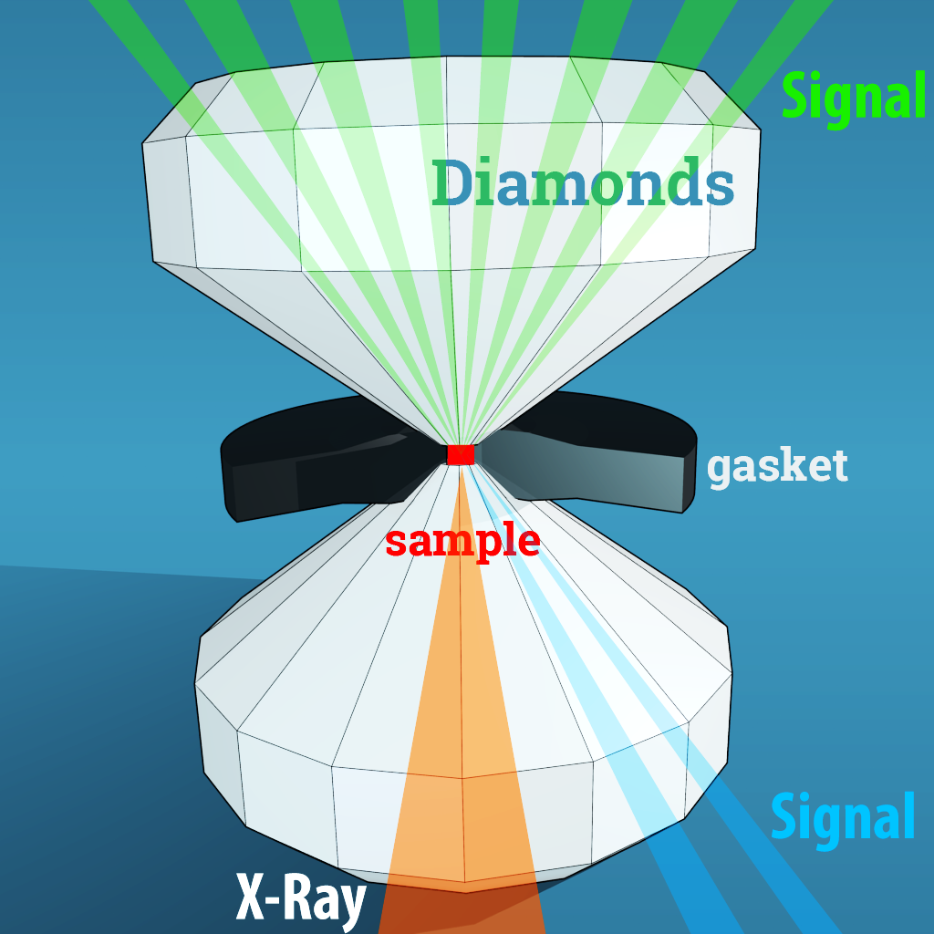
X-ray diffraction in a DAC
Force is applied along a certain axis
X-rays perpendicular to compression
X-rays uniaxial with compression
Strongly non-hydrostatic conditions
Quasi-hydrostatic conditions

Slide 17
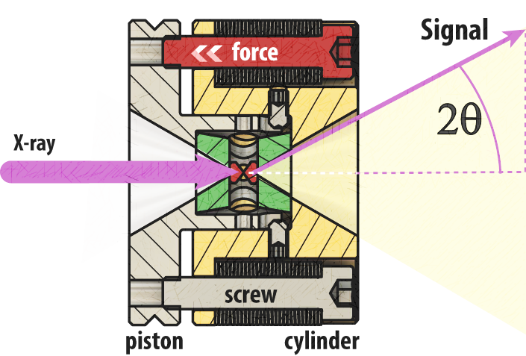
X-ray diffraction in a DAC
Limiting factor:
Opening of the cells
In reality you should think in d-spacing or Q range coverage (Bragg law)
Energy is important!!!
For monochromatic beam
42keV ; λ=0.29 Å
2θ≈25º – powder
2θ≥28º – single crystal
optimal - 35º
Mao-type cell

Slide 18
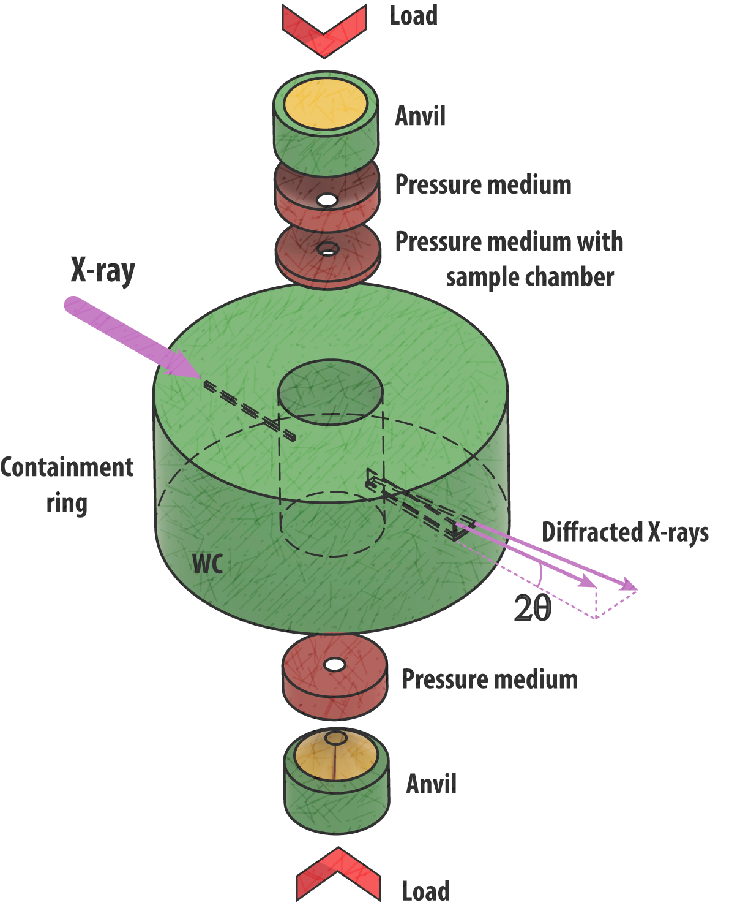
Large volume press (Drickhamer)
Relatively small press
Can generate over 30 Gpa with
Sample about 0.2-0.3 mm in linear dimension
after Y. Wang (2010)
White beam & monochromatic beam
Balchan & Drickhamer (1961)

Slide 19
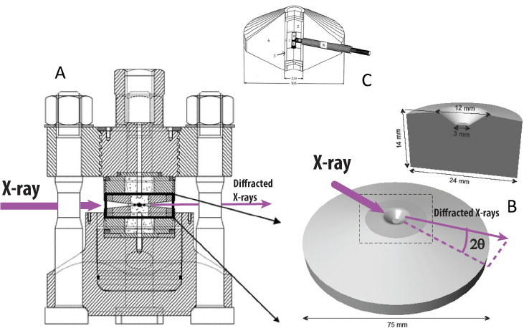
Large volume press (Paris-Edinburg)
White beam &
monochromatic beam
after G. Shen (2014)
Anvil
Hydraulic compact press with almost spherical sample chamber (≤1mm³)
up to 20-30GPa with sintered diamond anvils and high temperature (2000K)

Slide 20
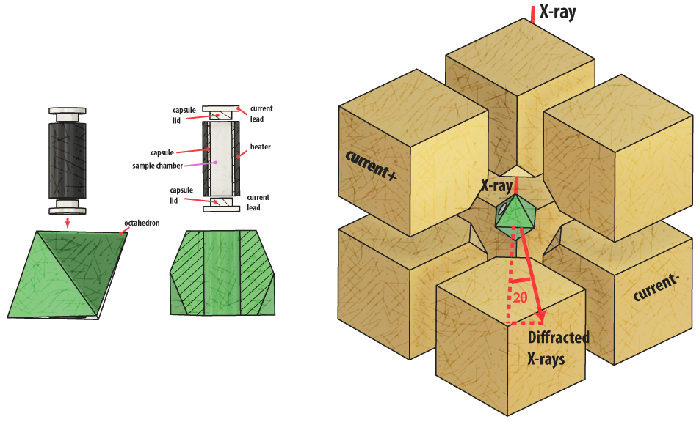
Large volume press (Multianvil)
Octahedron as complex sample chamber
WC or
synt. diamond
anvil
after Y. Wang (2010)
Highest pressure depends on assembly (smallest volume)
and anvil material
Synthesis, stress-strain relations, most versatile in D-DIA modification
White beam & monochromatic beam

Slide 21
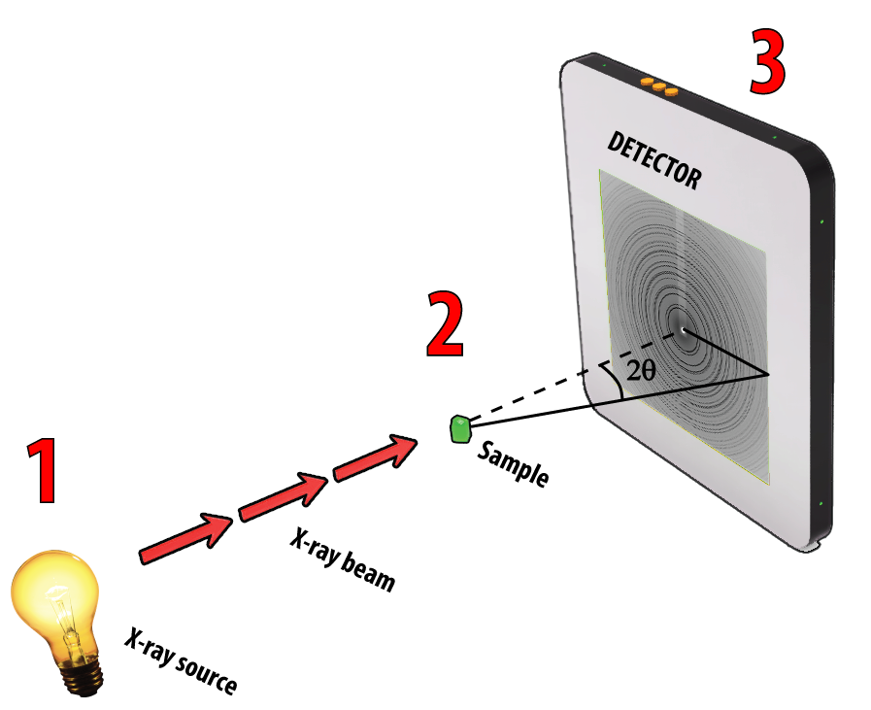
X-ray data collection schemes

Slide 22
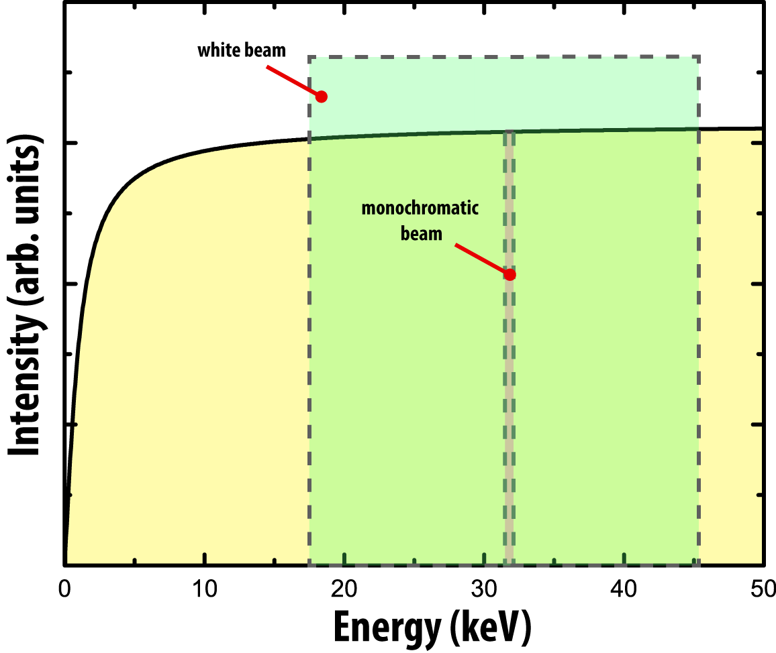
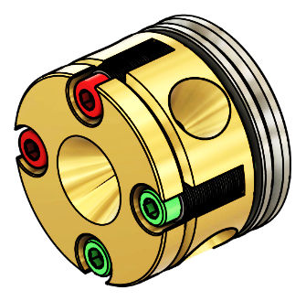
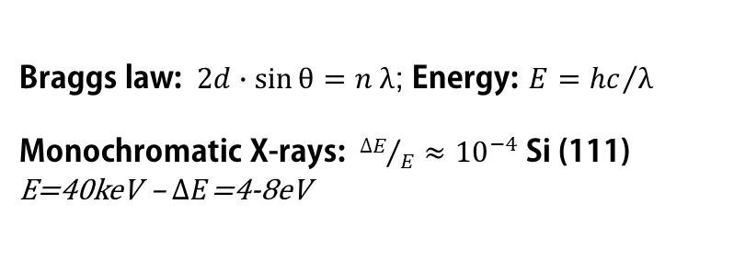
Source properties
Monochromatic
beam
White beam
Braggs law: $2d∙\sin{θ=n λ}$; Energy: $E={hc}/λ$
Monochromatic X-rays: ${∆E}/E≈{10}^{−4}$ Si (111)
E=40keV – $∆E$=4-8eV

Slide 23
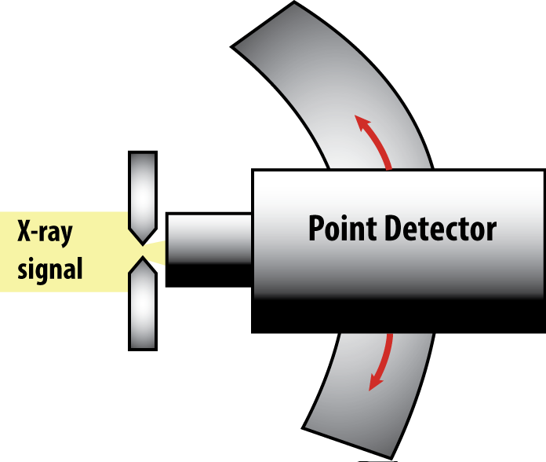
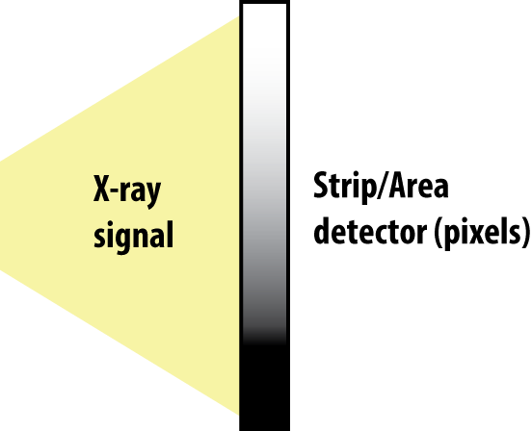
Detection principle
Ge or Si
based
Monochromatic
beam
White beam

Slide 24
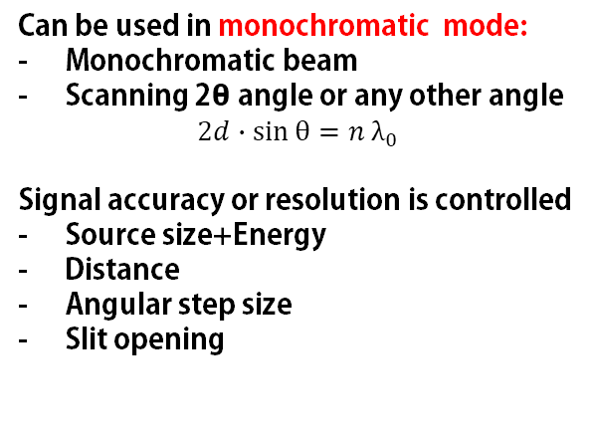
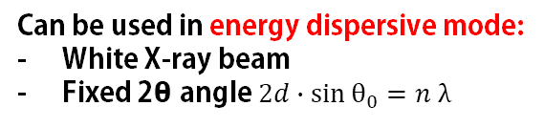
Detection principle – with point detector
Ge or Si
based
slits
Can be used in energy dispersive mode:
White X-ray beam
Fixed 2θ angle $2d∙\sin{θ_{0}=n λ}$
Can be used in monochromatic mode:
Monochromatic beam
Scanning 2θ angle or any other angle
$$2d∙\sin{θ=n λ_{0}}$$
Signal accuracy or resolution is controlled
Source size+Energy
Distance
Angular step size
Slit opening

Slide 25
Detection principle – with 1D/2D detector arrays
Slowly replace point detectors for monochromatic applications
Area collection is faster then point by point collection
2D signal collection + higher and higher detection efficiency
Resolution is controlled by:
Energy+Focusing
Distance
Pixel size
Image plate, CCD, Flat panel,
CMOS single photon counting panels

Slide 26
Detection principle
?
What is better:
Area detector
Point detector

Slide 27
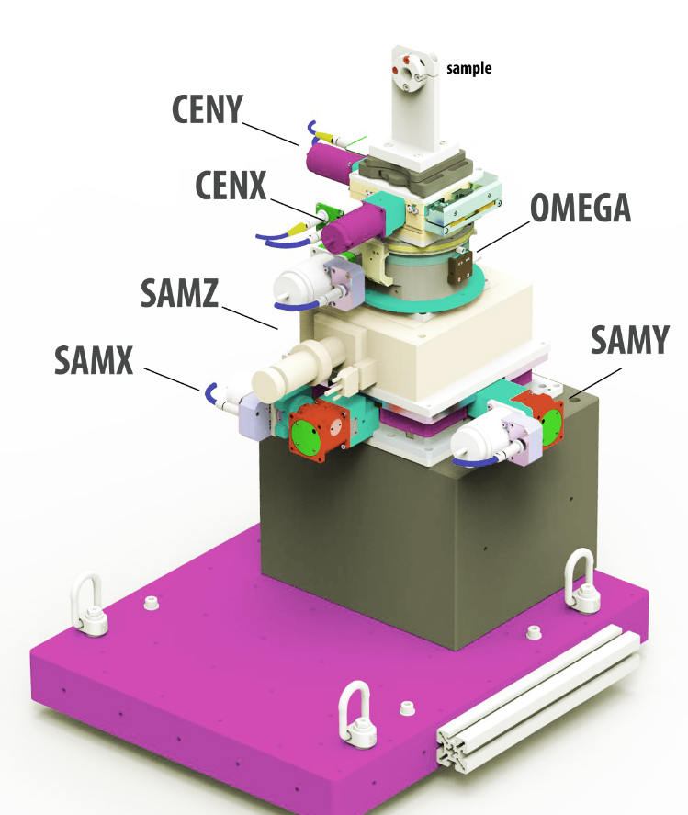
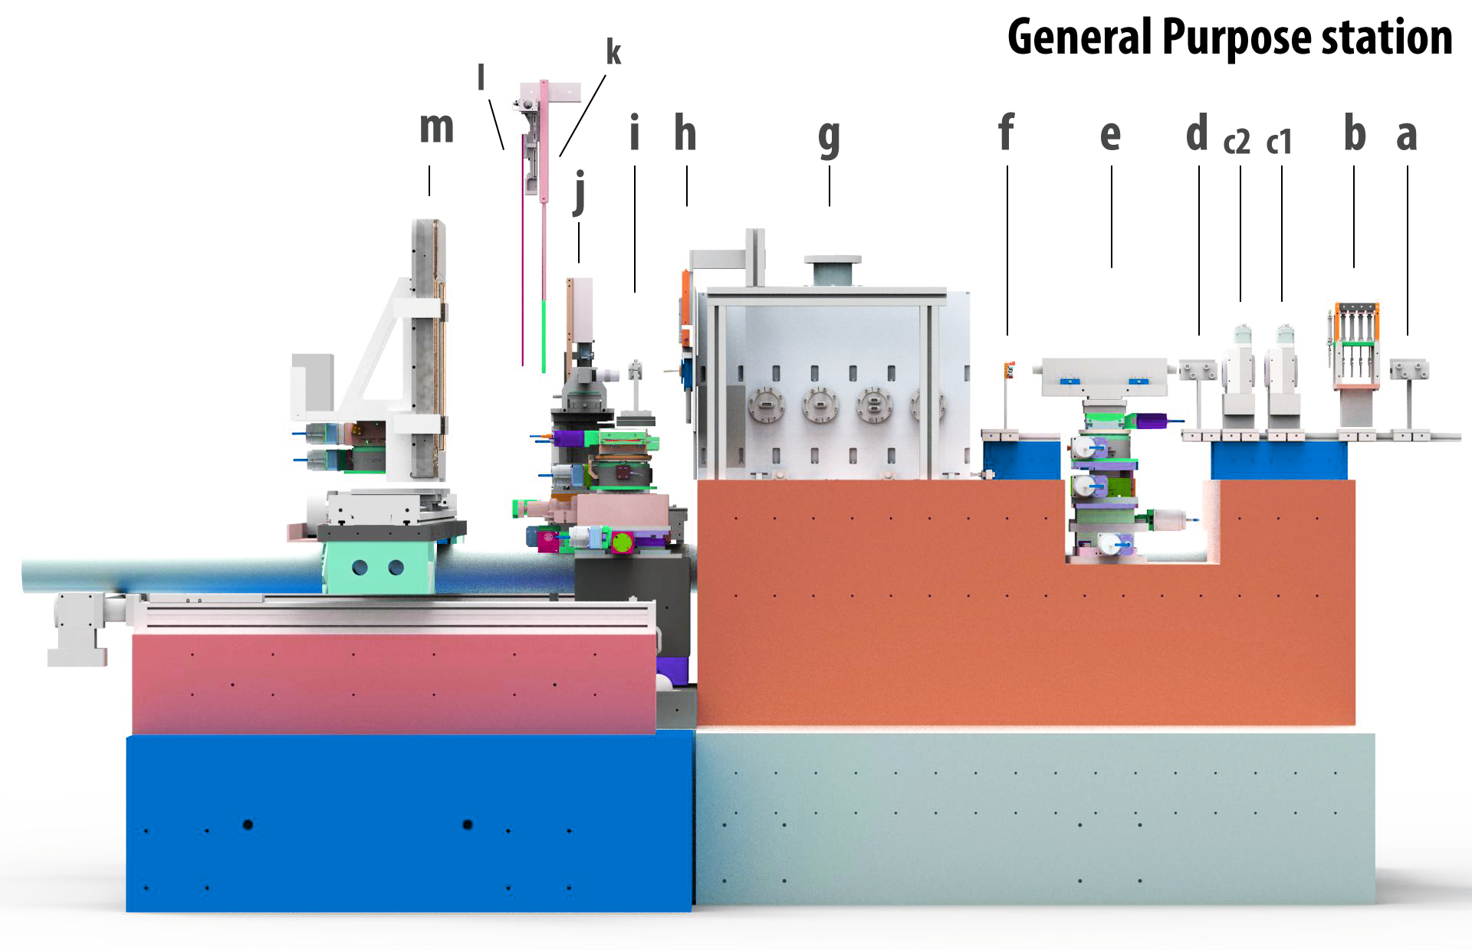
Typical DAC experiment (monochromatic beam)

Slide 28
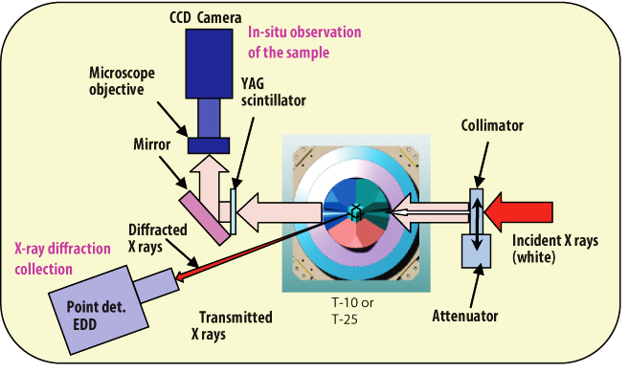
Typical Multi-Anvil experiment (white beam)
after Wang (2010)

Slide 29
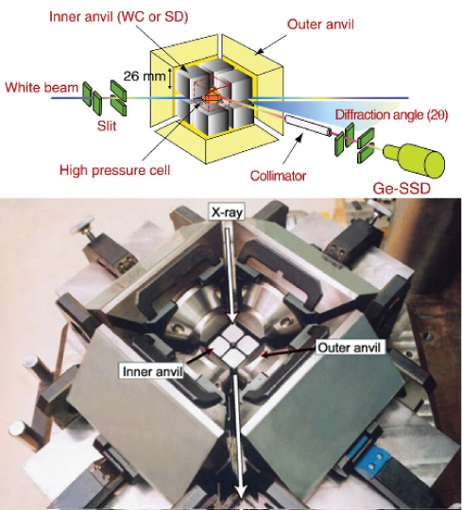
Typical Multi-Anvil experiment
SPEED-1500, a 6/8 system at SPring-8 (Spring-8 website)

Slide 30
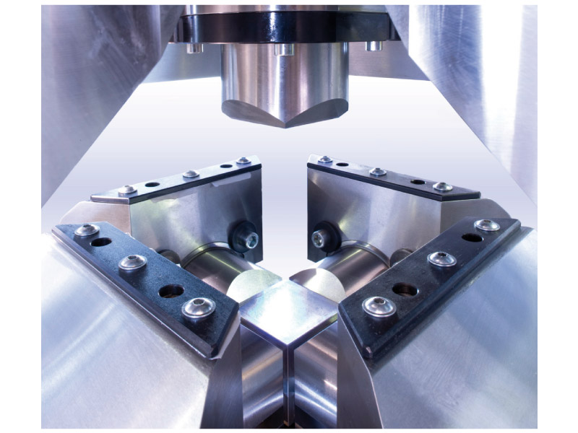
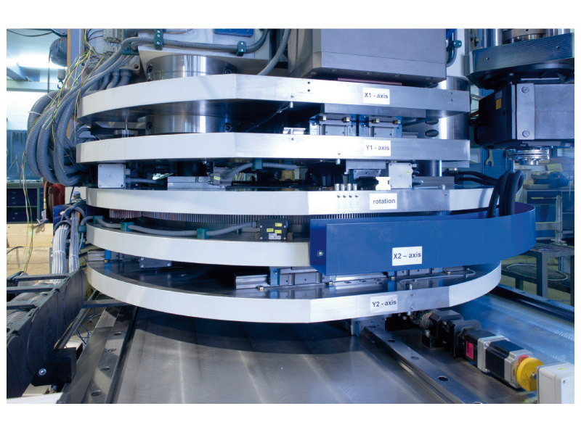
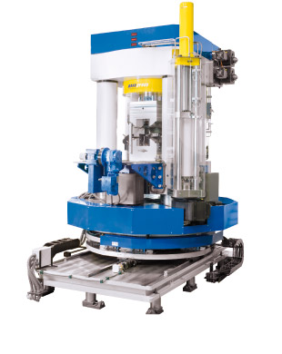
Typical Multi-Anvil experiment
X-ray
38ton - 20 MN (Voggenreiter site)
similar to one installed at ID06 (ESRF)

Slide 31
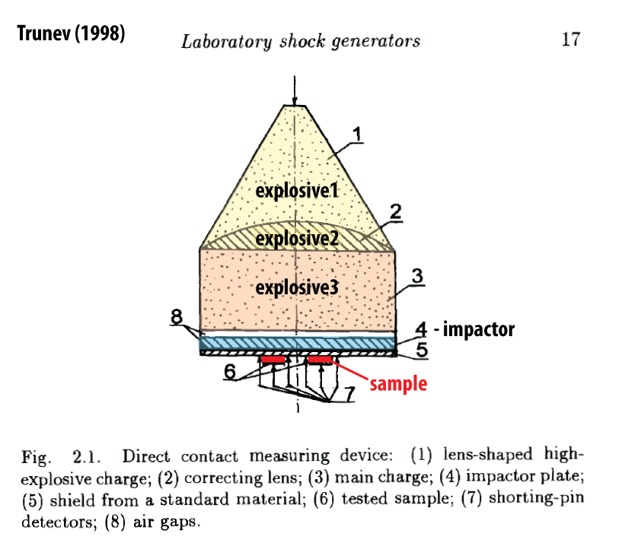
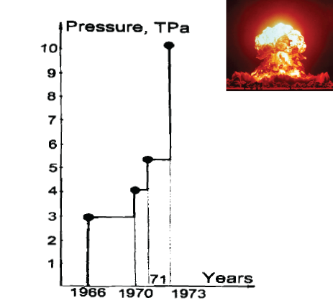
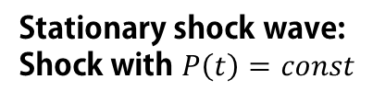
Shock compression environments
Stationary shock wave:
Shock with $P\left(t\right)=const$
Maximal available pressure on iron during underground nuclear tests
2-6x10-60mm

Slide 32
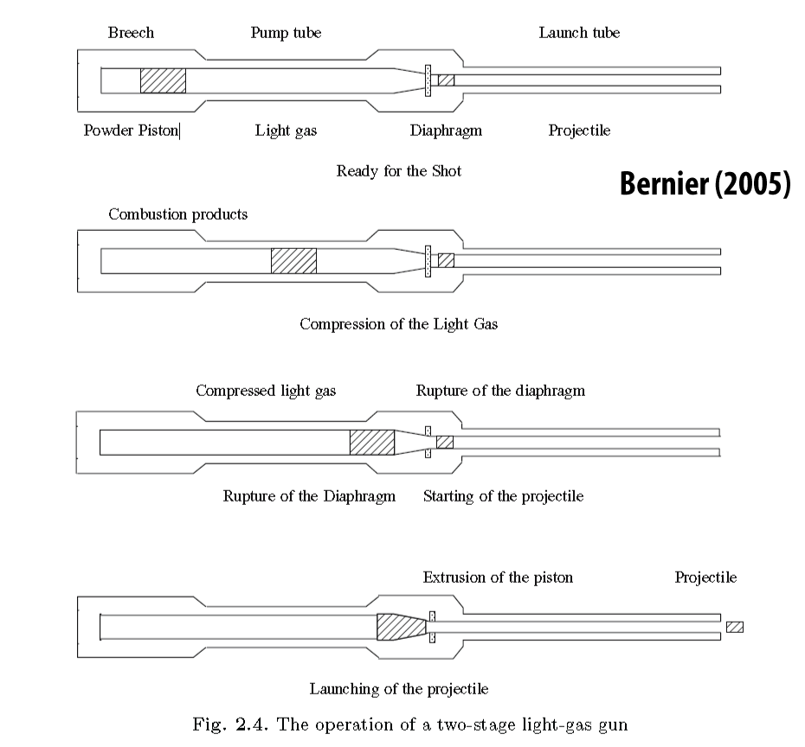
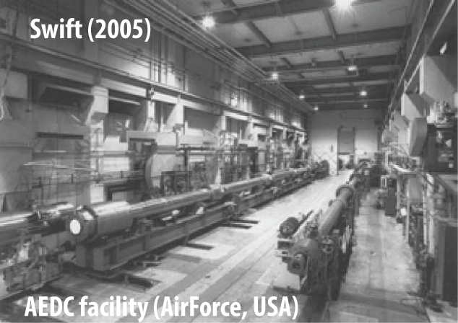
Shock compression environments
Light gas guns
Fire projectile, hit target, create shock

Slide 33
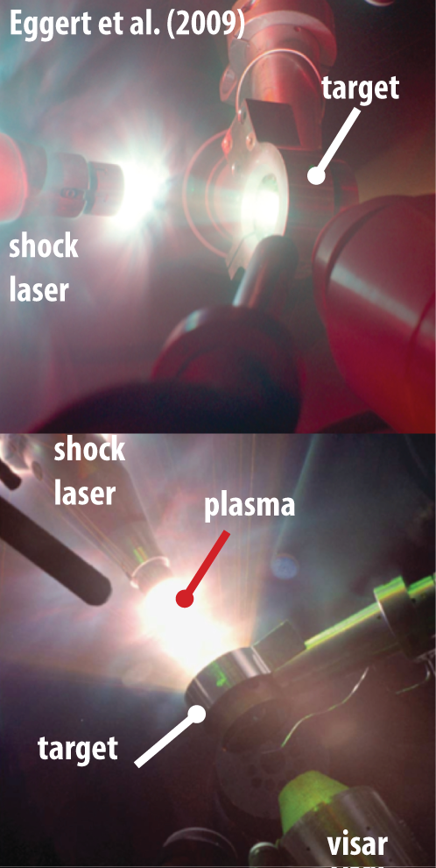
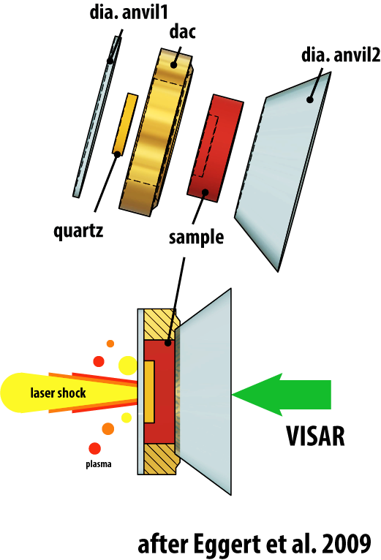
Shock compression environments
in vacuum

Slide 34
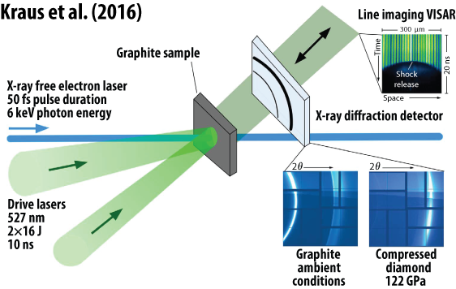
Shock compression environments
VISAR records reflectivity change on a back of a target as a function of time
Detects shock propagation time
Usage of X-ray free electron laser is a must for such studies:
extreme time resolution, extreme pulse intensity
High temperature is a by product of shock compression.

